Slide 1
Text Mining with R: Chapter 3-4
Judith Borghouts
29 March 2021

Slide 2
Term frequency (tf)
Term frequency (tf): frequency that a term occurs in document / total n of words in document

Slide 3
Inverse document frequency (idf)
Inverse document frequency (idf): log (number of documents / number of documents containing term)
Idf is low/near zero for words that occur in many of the documents

Slide 4
Tf-idf
Measures the importance of words in a particular document, relative to the corpus
Decreases weight for words that are common across documents in corpus
Increases weight for words that are not common in the corpus
bind_tf_idf(word, book, n)

Slide 5
Exploring relationships between words: N-grams
Tokenizes sequences of adjacent words rather than individual words (bigrams, trigrams, etc.)
Can provide context in sentiment analysis (‘happy’ vs ‘not happy’)
Ngrams overlap (‘sense and sensibility’ contains bigrams ‘sense and’ & ‘and sensibility’)
Stop words can be filtered out of ngrams using separate/filter/count/unite

Slide 6
Exploring relationships between words: Network visualizations
Visualize relationships among words using igraph package and ggraph function
Graph uses three variables from tidy object

Slide 7
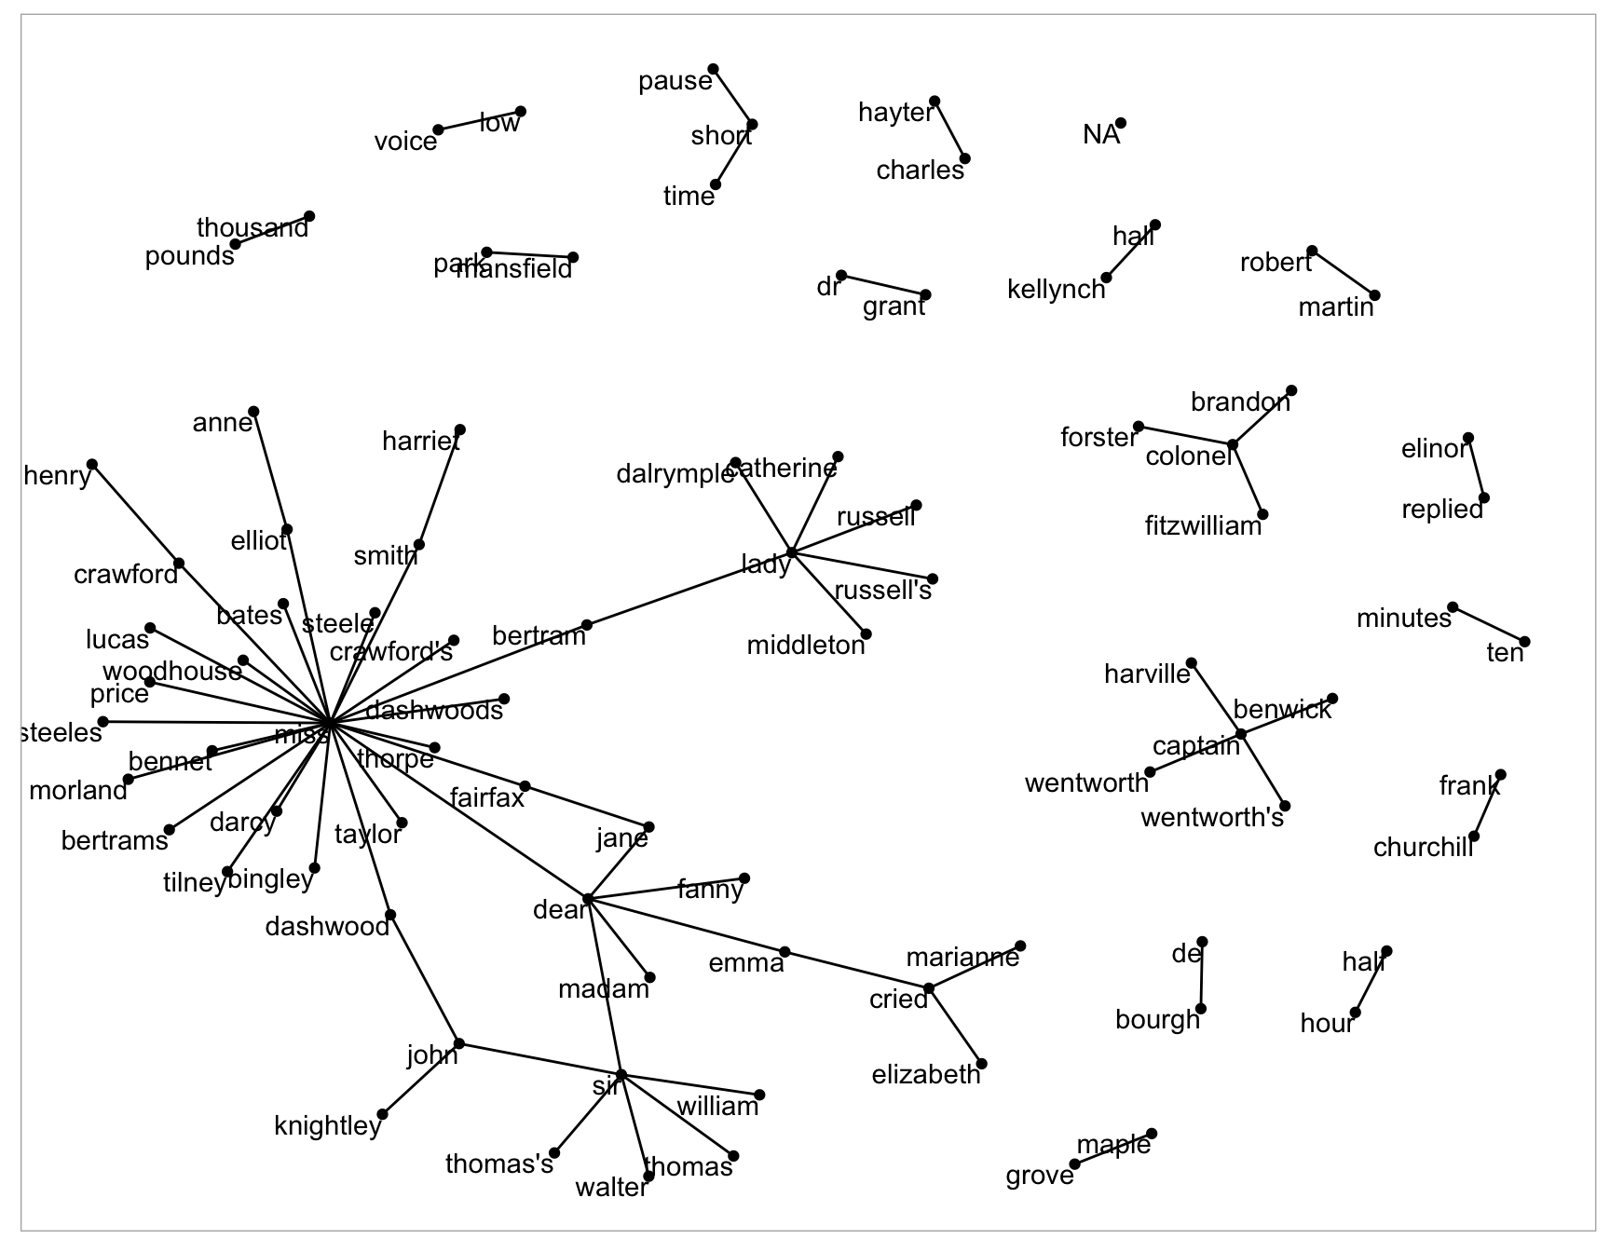
Exploring relationships between words: Network visualizations
Visualize relationships among words using igraph package and ggraph function
Graph uses three variables from tidy object

Slide 8
Exploring relationships between words: Pairwise counts/correlations
Co-occurrence of words (eg within documents or chapters) that do not necessarily occur next to each other
widyr ‘widens’ data, performs operation, and re-tidies data
pairwise_count(word, section)
Counts common pairs of words co-appearing within the same section
pairwise_cor(word, section)
Phi coefficient: focuses on how much more likely it is that either both word X and Y appear, or neither do, than that one appears without the other

Slide 9
Exercise 1
Find the top 5 highest tf-idf bigrams per book.

Slide 10
Exercise 2
Find trigrams that occur more than once in the novel Sense and Sensibility.

Slide 11
Exercise 3
Visualize words in Pride and Prejudice that have at least a 0.1 correlation with the word ‘darcy’.

